Slide 1
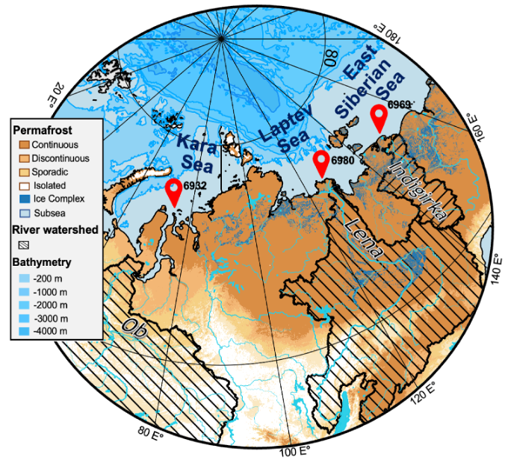
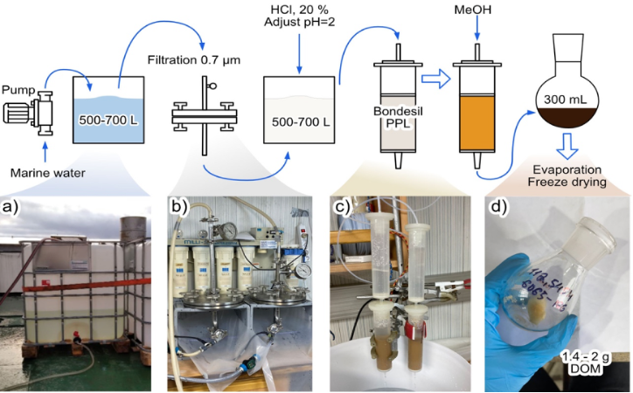
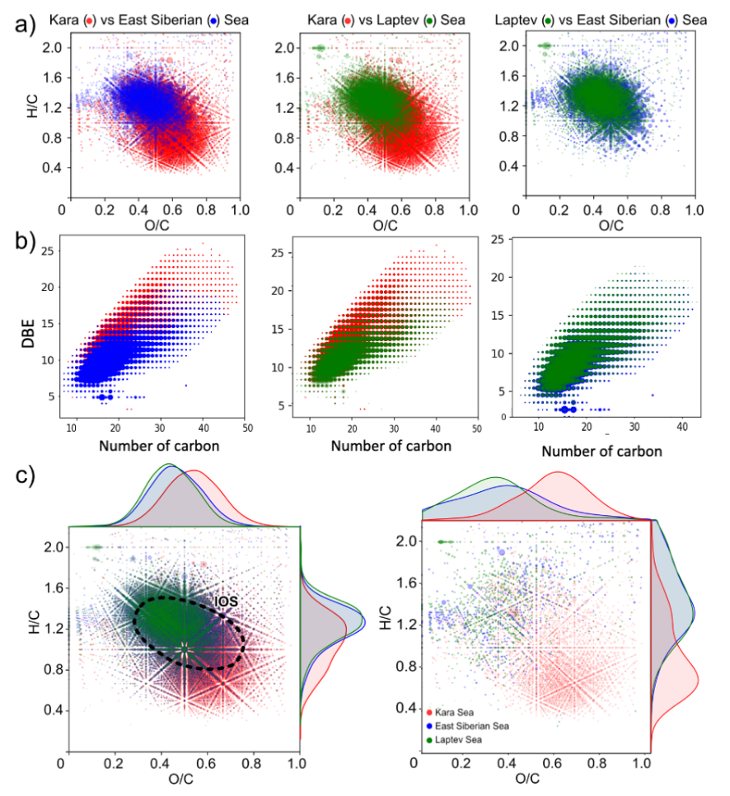
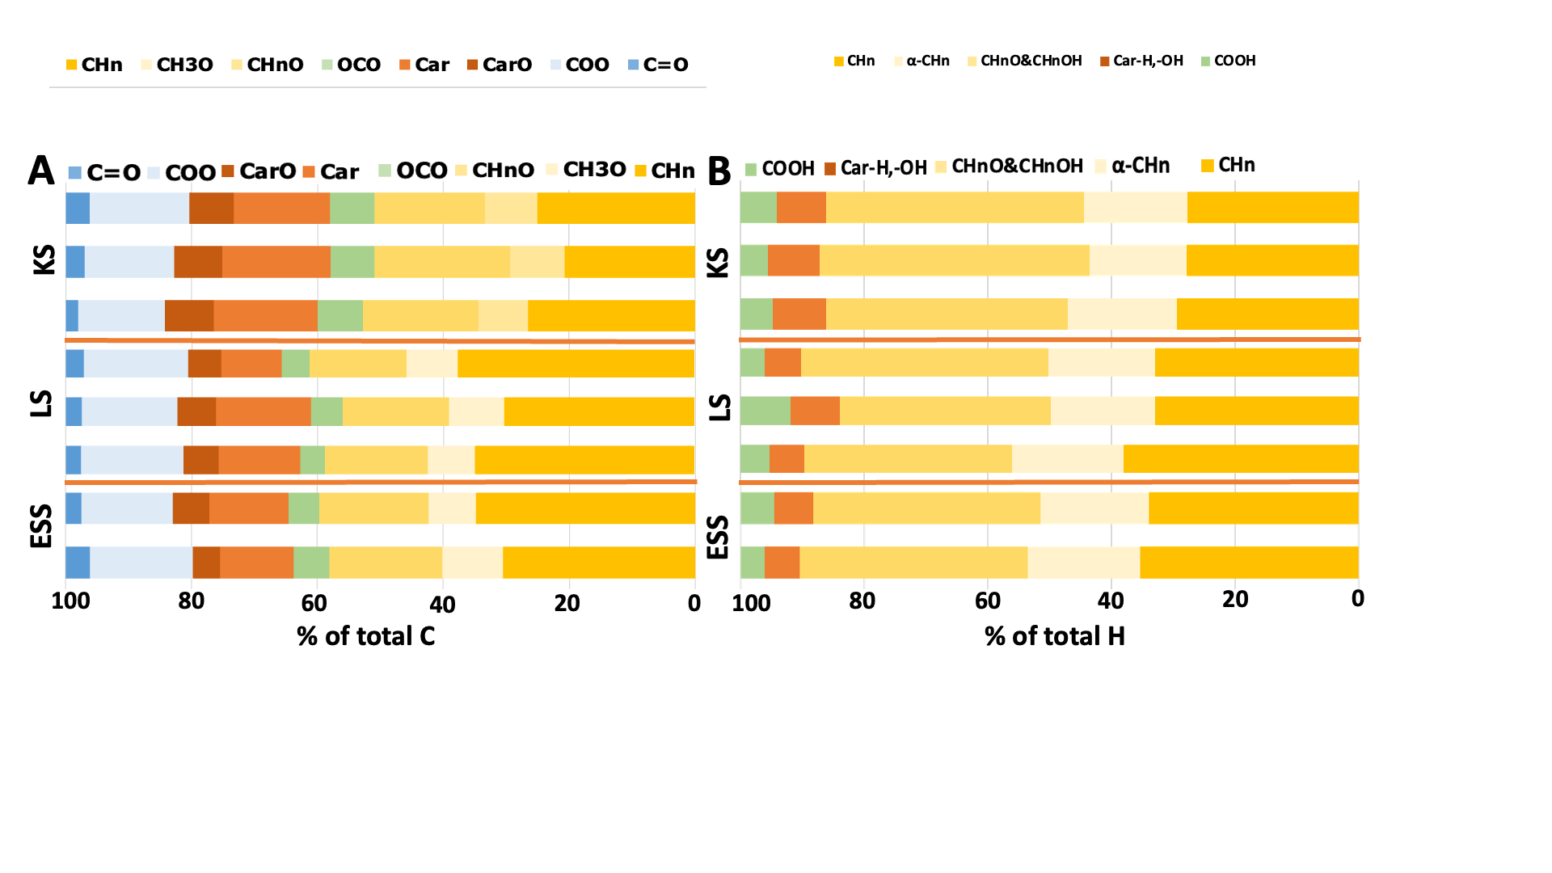
MOLECULAR CHARACTERISTICS OF DISSOLVED ORGANIC MATTER IN THE SIBERIAN ARCTIC SEAS: AN EASTWARD INCREASE IN REDUCED AND LOW OXIDIZED COMPONENTS
Anna N. Khreptugova¹, Alexander B. Volikov¹, Tatiana A. Mikhnevich¹, Nikita A. Sobolev¹, Andrey I. Konstantinov¹, Felipe Matsubara^{2,3}, Igor P. Semiletov^{4,5}, and Irina V. Perminova¹
¹ Lomonosov Moscow State University. Department of Chemistry, Moscow, Russia.
² Stockholm University. Department of Environmental Science, Stockholm, Sweden.
³ Bolin Centre for Climate Research, Stockholm University, Sweden
⁴ Pacific Oceanological Institute, Far Eastern Branch of the Russian Academy of Sciences, Russia
⁵ National Tomsk State University, Russia
E-mail: khreptugova@mail.ru
INTRODUCTION Arctic ecosystems are strongly affected by climate change, with warming four times faster than the global average. Thawing permafrost leads to increased organic carbon in Arctic rivers and the Arctic Ocean. The release of permafrost organic carbon can impact the molecular composition of dissolved organic matter (DOM) in the Arctic Ocean [1]. Establishing a chemical fingerprint is crucial for monitoring these changes. This study aims to isolate gram-quantities of DOM samples from the Arctic Siberian Shelf Seas and characterize them using advanced analytical techniques like FT ICR MS, NMR spectroscopy, fluorescence, and UV-Vis spectroscopy.
SAMPLE SITE
The large-scale SPE setup was conducted during the International Siberian Shelf Study 2020 aboard the research vessel "Academician Mstislav Keldysh" (AMK-82). The study took place in three regions: Kara Sea, influenced by the Ob-Irtysh River basin, located in the discontinuous or sporadic permafrost zone, Laptev Sea and East Siberian Seas, affected by the river basins of Lena, Indigirka, and Kolyma, which are situated in the continuous permafrost region.
Construction of the large-scale SPE system
A HDPE tank filled with filtered seawater was connected to SPE cartridges containing 15 g of Bondesil PPL bulk sorbent. The SPE process was made parallel by splitting the PVC pipe into two lines. The SPE isolation was performed following [2], using four cartridges per one water volume. Acidified water samples (500-700 L) were pumped through the cartridges at a constant rate 100 mL/min. Cartridges were exchanged midway to maintain high sorbent recovery. The extraction was performed onshore using methanol.
Figure 2. The principal scheme of DOM isolation from large volume of sea water.
Figure 1. The Siberian Arctic Shelf sampling sites
METHODS
UV-VIS measurements were conducted using a Carry 400 Probe spectrometer in the 200-800 nm range. Fluorescence spectra were obtained with a Jobin Yvon Horiba Fluorolog Tau-3 Lifetime System fluorometer at ℷ_{ex} 280 nm and
ℷ_{em} from 300 to 700 nm.
Quantitative ¹H and ¹³C solution state NMR spectra were obtained using an Avance-400 spectrometer operating at 400 MHz proton frequency. For ¹³C NMR, samples were dissolved in 99.9% D₂O, and for ¹H NMR, DMSO-d₆ was used.
Ultrahigh-resolution mass spectra were obtained using a Bruker solariX 15 T FT ICR mass spectrometer. Molecular formulae assignment were performed using the NomSpectra software [3].
UV-Vis MEASUAREMENTS The samples from the Kara Sea exhibited higher absorbance values and a more aromatic character, as indicated by the SUVA₂₅₄ and E₄/E₆ parameters. In contrast, the samples from the East Siberian Arctic Shelf had lower absorbance and showed more protein-like fluorescence. The optical indices suggested variations in molecular weight and the presence of aromatic structures, highlighting the influence of aliphatic-enriched permafrost organic carbon in the DOM samples from the East Siberian region.
FT ICR MS The analysis of FT ICR MS data revealed notable variations in the molecular composition of DOM isolated from the eastern (Laptev and East Siberian) and western (Kara) Arctic Seas. The Kara Sea sample showed higher hydrolysable tannins, while the Laptev and East samples had a larger proportion of lignins and terpenoids. This comparison indicated a significant red-ox gradient across the Arctic Shelf from west to east, with the DOM becoming less oxidized and more reduced due to the contribution of "fresher" DOM from continuous permafrost thawing.
NMR SPECTROSCOPY The Laptev and East Siberian Seas samples had a higher percentage of non-substituted aliphatic structures (30% to 37% of total carbon), while the Kara Sea isolates contained 20% to 27% of CHn structures. Kara Sea samples contained up to 25% aromatic carbon, while Laptev and East Siberian samples had up to 20%.
The ¹H NMR data showed similar trends, with East Siberian Arctic Sea isolates having a higher percentage of protons in non-substituted aliphatic groups compared to the Kara Sea DOM. Conversely, the Kara Sea isolates had a higher amount of O-substituted aliphatic fragments and protons of aromatic structures.
Figure 3. UV-Vis spectra (A), Fluorescence spectra obtained at 280 nm excitation wavelength (B), and optics parameters (C-F) of the Arctic DOM isolates.
Figure 4. The molecular composition of DOM isolates from the Kara, Laptev, and East Siberian Seas. The "island of stability" components are represented by the black area.
Figure 5. Distribution of integral intensities of C atoms (A) and H atoms (B) in the certain chemical environment (demonstrated in the upper row of the figure) in the DOM isolates as measured by ¹³C and ¹H NMR spectroscopy.
CONCLUSION This study isolated DOM from three Arctic regions as a reference point for future research. Comparing the DOM from the Kara Sea and East Siberian Arctic Shelf Seas revealed significant differences. Kara Sea DOM had higher hydrolysable tannin content, while the Laptev and East Siberian Seas DOM were dominated by saturated lignin and terpenoid components. Optical studies showed a red-ox gradient from west to east, with Kara Sea DOM more oxidized and East Siberian Arctic Seas DOM more reduced. The discharge of aliphatic DOM from thawing continuous permafrost contributes to the reduced character in the eastern Eurasian Arctic margin, underscoring its role as a long-term source of carbon dioxide in the Arctic.
REFERENCES
ACKNOWLEDGEMENTS
[1] Spencer, R. G. M.; Mann, P. J.; Dittmar, T.; Eglinton, T. I.; McIntyre, C.; Holmes, R. M.; Zimov, N.; Stubbins, A. Detecting the Signature of Permafrost Thaw in Arctic Rivers. Geophys Res Lett 2015, 42 (8), 2830–2835.
[2] Dittmar, T.; Koch, B.; Hertkorn, N.; Kattner, G. A Simple and Efficient Method for the Solid-Phase Extraction of Dissolved Organic Matter (SPE-DOM) from Seawater. Limnol. Oceanogr.: Methods 2008, 6, 230–235.
[3] A. Volikov, G. Rukhovich, I.V. Perminova. NOMspectra: An Open-Source Python Package for Processing High Resolution Mass Spectrometry Data on Natural Organic Matter. J. Am. Soc. Mass Spectrom. 2023.
The authors acknowledge the financial support provided by the Russian Science Foundation grants #21-77-30001 and #21-73-20202. The research of I.V.P. and A.I.K. was partially supported by state budget funding 122040600057-3. The authors also express gratitude to the Zelinsky IOC RAS for providing access to the Solarix XR 15T FT ICR MS mass spectrometer. The interdisciplinary program of the Scientific Educational School of Lomonosov MSU “Future of the planet and global environmental change” is appreciated.

