Slide 1
A.N. Frumkin
Institute of Physical Chemistry and Electrochemistry
Institution of Russian Academy of Sciences
31 Leninsky prospect, Moscow GSP-1, 119071 Russia
Thermodynamics of Hydrogen Bonding: from Experimental Measurements to Structure-Property Modeling
Vitaly Solov’ev ¹, Marta Glavatskikh ^{2,3}, Timur Madzhidov ³, Dragos Horvath ², Gilles Marcou ², Alexandre Varnek ²
¹ Laboratory of New Physico-Chemical Problems
A.N. Frumkin Institute of Physical Chemistry and Electrochemistry , Russian Academy of Sciences, Leninskiy prospect, 31, 119071, Moscow, Russia
² Laboratoire de Chémoinformatique
UMR 7140 CNRS, Université de Strasbourg, 1, rue Blaise Pascal, 67000 Strasbourg, France
³ Laboratory of Chemoinformatics and Molecular Modeling
Butlerov Institute of Chemistry, Kazan Federal University, Kremlevskaya, 18, Kazan, Russia
E-mail: solovev-vp@mail.ru
Notes:
Prediction of Halogen-Bond Strength by Ensemble QSPR

Slide 2
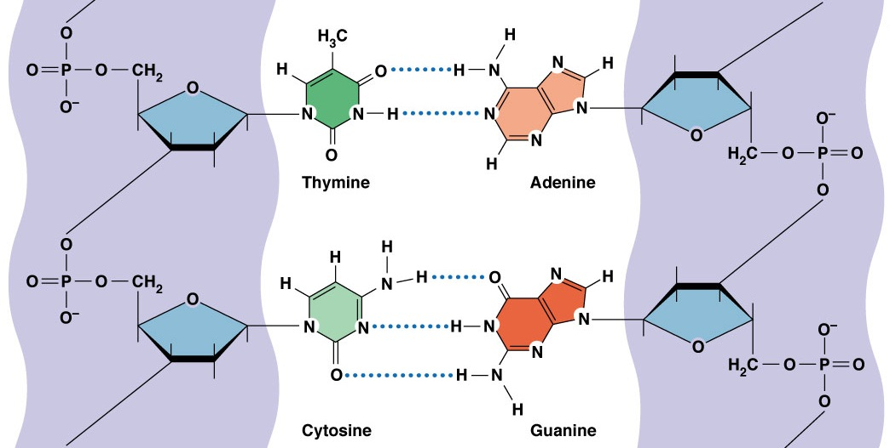
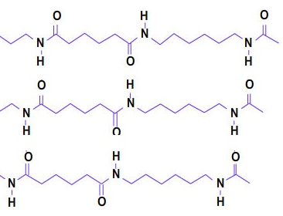
Hydrogen Bonding
Fundamental interaction
hydrogen bond (HB)
―X-H . . . Y―
X, Y = O, N, S, F
hydrogen bonds in DNA
hydrogen bonds in nylon
.
.
.
.
.
.
thymine
adenine
.
.
.
.
.
.
cytosine
guanine
Ruggiu F., Solov'ev V., Marcou G., Horvath D., Graton J., Le Questel J.-Y., Varnek A. Mol. Inf. 2014, 33, 477–487
Notes:
Recently, we discussed here, that the hydrogen bond is one of the fundamental interactions between molecules and defines many properties and processes of living and abiotic nature.
Hydrogen bonding interactions are widespread in biological systems.

Slide 3
Thermodynamic Functions of Hydrogen Bonding
Formation of single hydrogen bond
-X-H + Y = -X-H…Y
K = C_{XH…Y}/(C_{XH}.C_{Y}) stability constant
ΔG = - RT ln10 logK free energy
ΔH enthalpy
ΔS = (ΔH – ΔG) / T entropy
logK -1 … 6 ΔH -5 … -45 kJ/mol
Notes:
Thermodynamic data are very important for predicting the strength of hydrogen bonding.
The stability constant and Gibbs energy define percentage of reagents involved in the complexation in a system.
Enthalpy defines energy of bonding.

Slide 4
Thermodynamics of Hydrogen Bonding
Determination of Thermodynamic Quantities on the Basis of Experimental Methods
Predictive Models for the Free Energy of Hydrogen Bonded Complexes with Single and Cooperative Hydrogen Bonds
Notes:
My presentation includes two main parts:
Determination of Thermodynamic Quantities on the Basis of Experimental Methods
Predictive Models for the Free Energy of Hydrogen Bonded Complexes with Single and Cooperative Hydrogen Bonds

Slide 5
Thermodynamics of Hydrogen Bonding
Determination of Thermodynamic Quantities on the Basis of Experimental Methods
Notes:
First part of presentation concerns estimations of thermodynamic quantities by experimental methods

Slide 6
Thermodynamics of Hydrogen Bonding
Statistical data
15 000 ... 20 000 HB complexes
∼1 %
CCl4 ∼63 %
C6H12 ∼7 %
gas phase ∼5 %
C6H6 ∼3 %
≈ 70 solvents
X-H…Y
X⁺-H…Y
X-H…Y⁻
X⁺-H…Y⁻
OH…O ∼44 %
OH…N ∼22 %
NH…O ∼7 %
OH…π ∼5 %
≈ 110 combinations of X and Y
IR spectroscopy ∼50 %
UV-Vis spectroscopy ∼10 %
NMR spectroscopy ∼10 %
Calorimetry ∼10 %
≈ 20 physicochemical methods
Notes:
Some statistical data about measured thermodynamic quantities. Stability constant and enthalpy were measured more that 15000 HB complexes.
It is very small part data about HB complexes with cooperative H-bonds. logK or DG and DH values were estimated in 70 solvents, as a rule in CCl4.
It is known more that 100 combinations of X and Y atoms in different hybridization state involved in H-bonding, interaction of OH with O was measured
in 44% cases, OH with N – in 22 % cases.
About 20 physicochemical methods were applied for estimations of thermodynamic quantities. IR spectroscopy is most popular method.

Slide 7
Thermodynamics of Hydrogen Bonding
Relationships for estimation of thermodynamic quantities
$$Y=Y_{0}+a\sum_{i=1}^{s}{p_{i}C_{i}(β_{i}, …, β_{s})}$$
physicochemical property
$$\sum_{i=1}^{s}{ν_{ij}}C_{i}= C_{j}^{Σ}$$
material balance equations
j = 1,2,...,m
$$C_{i}=exp⁡(lnβ_{i}+\sum_{j=1}^{m}{ν_{ij}}C_{j})$$
equilibrium constants of reactions
(mass action law)
i = 1,2,...,s
V.P. Solov’ev, A.Yu. Tsivadze Protection of Metals and Physical Chemistry of Surfaces, 2015, 51, No. 1, pp. 1–35

Slide 8
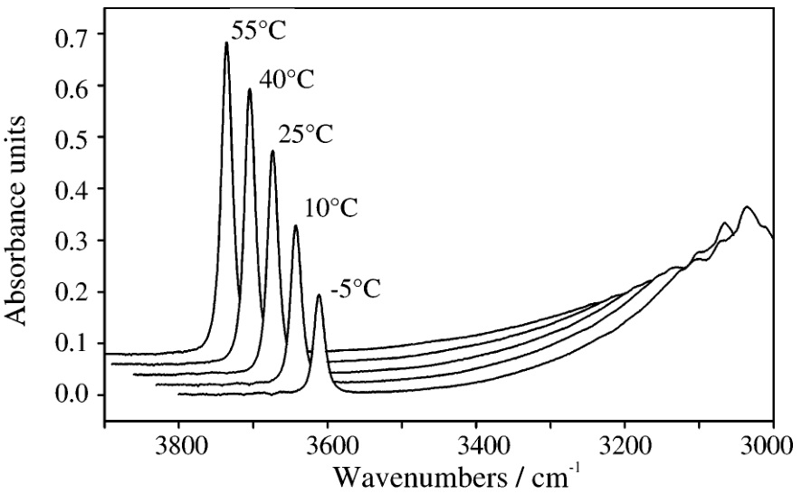
Thermodynamics of Hydrogen Bonding
IR Spectroscopy
in CCl₄
0.003 M
0.01 M
The OH band of free 4-fluorophenol at ≈ 3600 cm⁻¹
The OH band of the HB complex at ≈ 3000 cm⁻¹
J. Graton, M. Berthelot, F. Besseau, C. Laurence J. Org. Chem. 2005, 70, 7892-7901
Notes:
example of the hydrogen bonding between 4-fluorophenol and N,N′-dimethylpiperazine in CCl4

Slide 9
Thermodynamics of Hydrogen Bonding
IR Spectroscopy
D
A
$$A_{}$$ | Cº_{D}, M | Cº_{A}, M
0.36 | 0.003 | 0.01
0.42 | 0.003 | 0.015
0.51 | 0.003 | 0.02
... | ... | ...
$$A_{}$$
λ
$$A_{λ}=A_{0λ}+d\sum_{i=1}^{s}{ε_{iλ}C_{i}(β_{i}, …, β_{s})}$$
$$A_{}=A_{0}+d_{}C$$
O.A. Raevsky, A.F. Solotnov, V.P. Solov’ev Zhurnal Obshchei Khimii (Rus), 1987, 57, 1240-1243

Slide 10
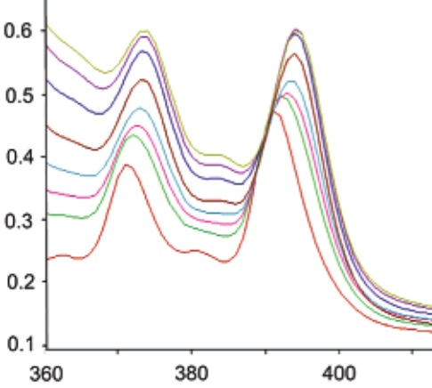
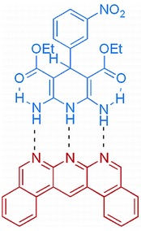
Thermodynamics of Hydrogen Bonding
UV-Vis Spectroscopy
Absorbance
$$A_{}$$ | Cº_{D}, M | Cº_{A}, M
0.38 | 10⁻⁶ | 10⁻⁵
0.44 | 2.10⁻⁶ | 10⁻⁵
0.47 | 5.10⁻⁶ | 10⁻⁵
... | ... | ...
D
A
$$A_{}$$
in CH₂Cl₄ at 293K
λ, nm
...
...
λ₁
λ_{m}
λ_{n}
$$A_{λ}=A_{0λ}+d\sum_{i=1}^{s}{ε_{iλ}C_{i}(β_{i}, …, β_{s})}$$
S. Djurdjevic, D.A. Leigh, H. McNab, S. Parsons, G. Teobaldi, F. Zerbetto J. Am. Chem. Soc. 2007, 129 , 476-477
Georg S., Billard I., Ouadi A., Gaillard C., Petitjean L., Picquet M., Solov’ev V. J. Phys. Chem. B, 2010, 114, 4276–4282
Notes:
UV/vis spectra in CH2Cl2 at 293 K upon the addition of HBD (from 0 to 1.2 equivalents) to HBA (1 × 10-5 M)

Slide 11
Thermodynamics of Hydrogen Bonding
NMR Spectroscopy
$$\text{}$$ | Cº_{D}, M | Cº_{A}, M
6.30 | 0.034 | 0.0034
6.54 | 0.033 | 0.0067
6.72 | 0.032 | 0.0096
... | ... | ...
δ, ppm
δ
7
6
δ, ppm
7
δ
6
$$=δ_{0}+\frac{1}{C_{R}^{Σ}}\sum_{i=1}^{s}{δ_{i}C_{i}(β_{i}, …, β_{s})}$$
V.P. Solov'ev, V.P. Kazachenko, V.O. Zavel'skii, L.V. Govorkova, O.A. Raevskii Koord. Khim. (Rus) 1987, 13, 909-913

Slide 12
Thermodynamics of Hydrogen Bonding
Calorimetric titration
-Q, J
+
=
in CCl₄ at 298K
Cº_{PhOH} , mol/l
Heat of hydrogen bonding versus analytical concentration of phenol
initial solution: 2 ml of MeP(O)(OMe)₂, Cº = 0.016 mol/l
titrant: 0.0106 ml of PhOH, Cº = 0.25 mol/l

Slide 13
Thermodynamics of Hydrogen Bonding
Calorimetric titration
-Q, J
-Q, J | Cº_{D}, M | Cº_{A}, M
0.051 | 0.0013 | 0.0159
0.049 | 0.0026 | 0.0158
0.047 | 0.0039 | 0.0157
... | ... | ...
Cº_{PhOH} , mol/l
$$Q=Q_{0}+ V_{f}\sum_{i=1}^{s_{f}}{ΔH_{i}C_{i}(β_{i}, …, β_{f})} − V_{b}\sum_{i=1}^{s_{b}}{ΔH_{i}C_{i}(β_{i}, …, β_{b})}$$
V.P. Solov'ev, D.B. Kireev, O.A. Raevskii, L.A. Chepakova, V.K. Brel’, I.V. Martynov
Zhurnal Obshchei Khimii (Rus), 1991, 61, 212-216

Slide 14
Thermodynamics of Hydrogen Bonding
Relationships for estimation of thermodynamic quantities
$$Y=Y_{0}+a\sum_{i=1}^{s}{p_{i}C_{i}(β_{i}, …, β_{s})}$$
physicochemical property
$$\sum_{i=1}^{s}{ν_{ij}}C_{i}= C_{j}^{Σ}$$
material balance equations
j = 1,2,...,m
$$C_{i}=exp⁡(lnβ_{i}+\sum_{j=1}^{m}{ν_{ij}}C_{j})$$
equilibrium constants of reactions
(mass action law)
i = 1,2,...,s
V.P. Solov’ev, A.Yu. Tsivadze Protection of Metals and Physical Chemistry of Surfaces, 2015, 51, No. 1, pp. 1–35

Slide 15
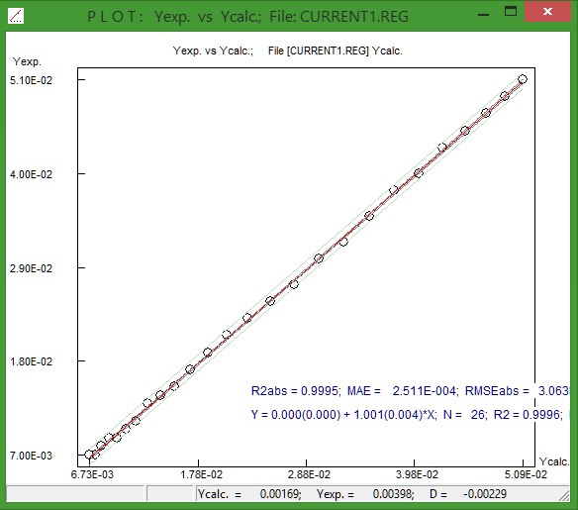
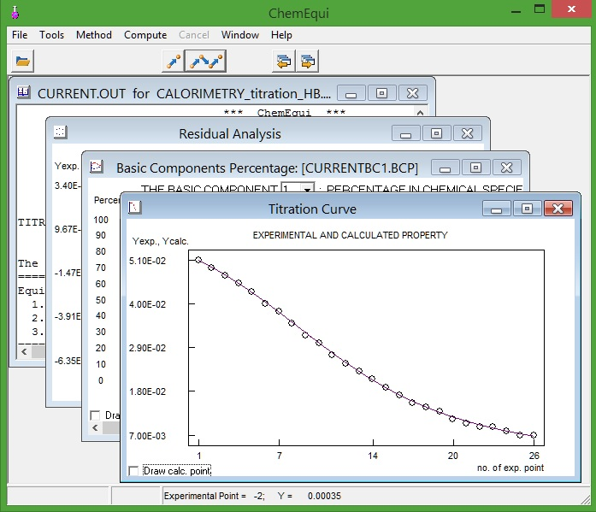
Thermodynamics of Complexation
ChemEqui Program for estimation of thermodynamic quantities
V.P. Solov’ev, A.Yu. Tsivadze Protection of Metals and Physical Chemistry of Surfaces, 2015, 51, No. 1, pp. 1–35
V. Solov’ev ChemEqui Program, http://vpsolovev.ru/programs/ 2016

Slide 16
Thermodynamics of Hydrogen Bonding
Predictive Models for the Free Energy of Hydrogen Bonded Complexes with Single and Cooperative Hydrogen Bonds

Slide 17
QSPR modeling of Gibbs energy for hydrogen bonding
Modeling workflow
Data preparation: 3373 HB complexes, ΔG values measured in CCl₄ at 298 K
Generation of different sets of ISIDA fragment descriptors
Obtaining and validation of ensemble of SVM and MLR individual models
Selection of the most predictive individual models for consensus calculations ("consensus model")
External test set:
629 HB complexes, ΔG values in various solvents (recalculated to CCl4)
at 293 - 298 K
External test set:
12 HB complexes with
cooperative hydrogen bonds

Slide 18
QSPR modeling of Gibbs energy for hydrogen bonding
Data sets
Data preparation: 3373 HB complexes, ΔG values measured in CCl₄ at 298 K
Generation of different sets of ISIDA fragment descriptors
Obtaining and validation of ensemble of SVM and MLR individual models
Selection of the most predictive individual models for consensus calculations ("consensus model")
External test set:
629 HB complexes, ΔG values in various solvents (recalculated to CCl4)
at 293 - 298 K
External test set:
12 HB complexes with
cooperative hydrogen bonds

Slide 19
QSPR modeling of Gibbs energy for hydrogen bonding
Data sets
+
=
...
HBA
HBD
HBA...HBD
Training set for external 3-fold cross-validation
ΔG values for 3373 HB complexes in CCl₄ at 298 K
External test set
ΔG values for 629 HB complexes
solvents: C₂Cl₄, C₆H₅Cl, C₆H₆, C₆H₁₂, CCl₃CH₃, C₂Cl₂H₄
temperature: from 293 to 298 K

Slide 20
QSPR modeling of Gibbs energy for hydrogen bonding
Distribution of free energy ΔG in training and external test sets
number of complexes
number of complexes
ΔG, kJ/mol
ΔG, kJ/mol
Training set
Test set

Slide 21
Hydrogen bond acceptors
Acceptor groups
no. | HB acceptor group | name
1 | >N- | amine nitrogen
2 | >N_{ar} | aromatic nitrogen
3 | >С=N- | imine nitrogen
4 | -C≡N | nitrile nitrogen
5 | -O- | ether, alcohol oxygen
6 | >C=O | carbonyl oxygen
7 | P=O | oxygen of phosphoryl group
8 | S=O | oxygen of sulfinyl, sulfonyl groups
9 | -NO₂ | nitro
10 | As=O | arsine
11 | >Se=O | selenyl
12 | -S- | sulfur of sulfide, thiols
13 | >C=S | sulfur of thiocarbonyl group
14 | P=S | sulfur of thiophosphoryl group
15 | -Se- | seleno
16 | >C=Se | selenone
17 | P=Se | phosphine selenide
18 | π-C_{sp2} | benzenes, alkenes
Notes:
HBAs can be categorized into 18 families according to HB acceptor group

Slide 22
Hydrogen bond donors
Donor groups
no. | HB donor group | name
1 | H-NR-C_{alk} | amine
2 | H-NR-C_{ar} | aniline
3 | H-N=C | imine
4 | H-N_{ar} | aromatic nitrogen
5 | H-N=S | aromatic fragment
6 | H-O-C_{ar} | hydroxyl of phenols
7 | H-O-C_{alk} | hydroxyl of alcohol
8 | H-O-O- | peroxy
9 | H-O-Si | silanol
10 | H-O-C(=O)- | carboxyl
11 | H-S-C_{alk} | tioalcohol
12 | H-S-C_{ar} | tiophenol
13 | H-C_{alk} | alkane
14 | H-CR=C | alkene
15 | H-C≡C | alkine
Notes:
HBDs can be categorized into 15 families according to HB donor group

Slide 23
QSPR modeling of Gibbs energy for hydrogen bonding
Data sets
Data preparation: 3373 HB complexes, ΔG values measured in CCl4 at 298 K
Generation of different sets of ISIDA fragment descriptors
Obtaining and validation of ensemble of SVM and MLR individual models
Selection of the most predictive individual models for consensus calculations ("consensus model")
External test set:
629 HB complexes, ΔG values in various solvents (recalculated to CCl4)
at 293 - 298 K
External test set:
12 HB complexes with
cooperative hydrogen bonds

Slide 24
QSPR modeling of Gibbs energy for hydrogen bonding
ISIDA fragment descriptors
*
*
H-Bond acceptor
H-Bond donor
molecular fragment | count
C÷C÷N* | 2
C÷C÷N | 2
C-C-C=O | 3
... | ...
molecular fragment | count
C-C-O* | 2
C-C-O | 2
C-C-C=O | 1
... | ...
$$Gexp  G_{calc}= c_{0}+ c_{1}x_{1}+ c_{2}x_{2}+ c_{3}x_{3}+ c_{4}x_{4}+…+ c_{m}x_{m}$$
QSPR model

Slide 25
QSPR modeling of Gibbs energy for hydrogen bonding
Machine learning methods
Data preparation: 3373 HB complexes, ΔG values measured in CCl4 at 298 K
Generation of different sets of ISIDA fragment descriptors
Obtaining and validation of ensemble of SVM and MLR individual models
Selection of the most predictive individual models for consensus calculations ("consensus model")
External test set:
629 HB complexes, ΔG values in various solvents (recalculated to CCl4)
at 293 - 298 K
External test set:
12 HB complexes with
cooperative hydrogen bonds

Slide 26
QSPR modeling of Gibbs energy for hydrogen bonding
Machine learning methods
Support vector machines:
The LibSVM package [1, 2]
Ensemble Multiple Linear Regression method:
The ISIDA/QSPR software [3, 4]
1. D. Horvath, J. Brown, G. Marcou, A. Varnek Challenges, 2014, 5, 450
2. C.-C. Chang, C.-J. Lin ACM Trans. Intell. Syst. Technol., 2011, 2, 1-27
3. V. Solov’ev, A. Varnek http://infochim.u-trasbg.fr/spip.php?rubrique53 2016
4. V. Solov’ev, A. Varnek http://vpsolovev.ru/programs/ 2016
Notes:
QSPR models were obtained using support vector machines and ensemble multiple linear regression methods applying the LibSVM package and the ISIDA/QSPR software.
Our ISIDA/QSPR software is freely available by Internet.

Slide 27
Consensus modeling for predicting Gibbs energy
Selection of the most predictive models for consensus predictions
Generated Individual QSPR models
Q² > Q_{lim}²
(R² – Q²) < Δ_{lim}
Acceptable QSPR models
Applicability domain (AD)
Bounding Box
Fragment Control
Quorum Control
Applicable individual models
Excluding of outlying predictions
Thompson's rule
m
< Y_{pred} > = 1/m Σ Y_{pred, i}
i = 1
Consensus model
$$Y  G$$
27
Notes:
The forward and backward stepwise variable selection stage is performed accumulating the most relevant descriptors. Gibbs energy is reliable predicted by consensus models as an arithmetic mean of values obtained by individual models excluding those leading to outlying values and being outside applicability domains of some individual models.

Slide 28
QSPR modeling of Gibbs energy for hydrogen bonding
External 3-fold cross-validation
three folds
2
1
1
initial training
set
training sets
3
3
2
1
2
3
test sets
determination coefficient:
$$R_{det}^{2}=1−\sum_{i=1}^{n}{{\left(Y_{exp, i}−Y_{pred, i}\right)}^{2}}/\sum_{i=1}^{n}{\left({\left.Y_{exp, i}− {<Y>}_{exp}\right)}^{2}\right.}$$
root mean squared error :
$$RMSE=[ \frac{1}{n}\sum_{i=1}^{n}{\left(Y_{exp, i}− Y_{pred, i})^{2} \right.}]^{1/2}$$
$$Y ≡ Δ\text{G}$$
Notes:
Predictive performance of consensus models has been estimated using squared determination coefficient and the root mean squared error for a combination of all three test sets of three fold cross-validation. Here Y is the $\text{G}$ value for the complexation.

Slide 29
QSPR modeling of Gibbs energy for hydrogen bonding
External 3-fold cross validation
ΔG_{pred} kJ/mol
ΔG_{pred} kJ/mol
RMSE = 1.5
R²_{det} = 0.94
n = 3373
RMSE = 2.2
R²_{det} = 0.87
n = 3373
SVM
MLR
ΔG_{exp} kJ/mol
ΔG_{exp} kJ/mol
ΔG = -RT lnK
ΔG units, RMSE: 1.5 … 2.2
log K units, RMSE: 0.26 … 0.38

Slide 30
Stability constants of hydrogen bonding
accurate experimental estimations
log K
δ log K
δ ΔG
IR Calor
2.31 ± 0.04
2.59 ± 0.05
0.28
1.6
1.03 ± 0.02
1.35 ± 0.06
0.32
1.8
1.38 ± 0.08
1.57 ± 0.15
0.19
1.1
Raevsky O.A., Solotnov A.F., Solov’ev V.P. Zhurnal Obshchei Khimii (Rus), 1987, 57, 1240-1243
Raevsky O.A., Grigor’ev V.Yu., Solov'ev V.P. Zhurnal Obshchei Khimii (Rus), 1987, 57, 2073-2078
Grigor’ev V.Yu., Solov'ev V.P., Raevsky O.A. Zhurnal Obshchei Khimii (Rus), 1988, 58, 761-766

Slide 31
Hydrogen Bonding of Organic Acceptors with 4-F-Phenol
QSPR Modelling with ISIDA Local Descriptors
The 1:1 Complexation in CCl₄ at 298 K
logK
537 mono- and bi-functional H-bond acceptors: organic compounds
H-bond donor: 4-F-phenol
5-fold cross validation:
RMSE
log K units
ΔG units
0.24 ... 0.27
1.4 ... 1.5
Ruggiu F., Solov'ev V., Marcou G., Horvath D., Graton J., Le Questel J.-Y., Varnek A. Mol. Inf. 2014, 33 (6-7), 477-487

Slide 32
QSPR modeling of Gibbs energy for hydrogen bonding
External test set
ΔG_{pred} kJ/mol
ΔG_{pred} kJ/mol
RMSE = 3.4
R²_{det} = 0.73
n = 629
RMSE = 3.8
R²_{det} = 0.65
n = 629
SVM
MLR
ΔG_{exp} kJ/mol
ΔG_{exp} kJ/mol
ΔG, RMSE: 3.4 … 3.8
log K, RMSE: 0.60 … 0.66

Slide 33
Gibbs energy for hydrogen bonding
External test set: 629 hydrogen bond complexes
ΔG (in CCl₄) = a ΔG (in solvent) + b
at the temperatures from 293 to 298 K
δΔG ≈ 1.4
δΔG ≈ 0.4
no. | solvent | a ± Δa | b ± Δb | R² | s | n
1 | C₂Cl₄ | 0.975 ±0.027 | 0.42 ±0.29 | 0.982 | 0.70 | 25
2 | C₆H₆ | 1.024 ±0.034 | 1.44 ±0.30 | 0.916 | 1.62 | 87
3 | C₆H₅Cl | 1.089 ±0.062 | 0.02 ±0.66 | 0.951 | 1.13 | 18
4 | CCl₃CH₃ | 0.962 ±0.066 | 2.14 ±0.89 | 0.922 | 1.36 | 20
5 | 1,2-C₂H₄Cl₂ | 1.109 ±0.063 | 3.07 ±0.51 | 0.783 | 1.95 | 86
6 | C₆H₁₂ | 0.891 ±0.020 | 0.64 ±0.19 | 0.929 | 1.71 | 145
Notes:
error propagation

Slide 34
QSPR modeling of Gibbs energy for hydrogen bonding
Complexes with cooperative hydrogen bonds
Test set of complexes with two cooperative hydrogen bonds
ΔG values for 12 HB complexes in CCl₄ at 298 K
Notes:
Complexes with cooperative hydrogen bonds are important both for the understanding of biology and in the design of new materials.

Slide 35
QSPR modeling of Gibbs energy for hydrogen bonding
Complexes with cooperative hydrogen bonds
$${G}_{pred}= a\sum_{i=1}^{n}{{ΔG}_{pred, i}}$$
ΔG_{pred} kJ/mol
RMSE = 2.2
R²_{det} = 0.77
$a$= 0.60 ± 0.02 (SVM)
$a$= 0.66 ± 0.04 (MLR)
ΔG_{exp} kJ/mol
V. Solov’ev, A. Varnek, A. Tsivadze J. Comput.-Aided Mol. Des. 2014, 28, 549-564

Slide 36
CONCLUSIONS
Physicochemical methods including IR, UV-Vis, NMR spectroscopy and calorimetry are effective for estimations of thermodynamic quantities of hydrogen bonding. For biology and new material design, significance of cooperative H-bonds study is increased.
Consensus QSPR models of complexation free energy were elaborated on largest and structurally divers dataset of H-bond complexes. Developed models were then successfully applied to predict free energy of the complexes with single and cooperative H-bonds.
Notes:
CONCLUSIONS

Slide 37
ACKNOWLEDGMENTS
Prof. Alexandre Varnek
Prof. Igor Antipin
Acad. Aslan Tsivadze
Dr. Timur Madzhidov
Marta Glavatskikh
Dr. Dragos Horvath
Dr. Gilles Marcou
Organizers of International School-Seminar on Computer-Aided Molecular Design
Notes:
ACKNOWLEDGMENTS

